Slide 1
Canada School of Public Service Digital Academy
Who we are and what we do

Slide 2
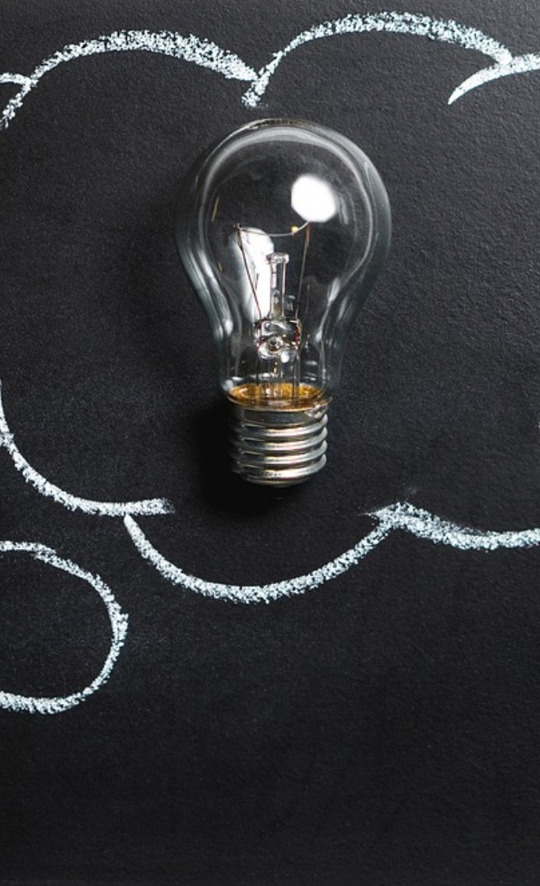
What and why
Concept
A teaching organization held at the Canada School of Public Service (CSPS) in partnership with the Office of the Chief Information Officer (OCIO) and the Canadian Digital Service (CDS).
Objectives
Work with partners and experts to develop in our people the foundational, specialist and leadership digital skills needed to meet expectations of Canadians.
Build diverse and inclusive communities and networks to support continuous and social learning
Re-focus learning on the practical application of tomorrow’s technology and tools.
Notes:
Digital Academy: what and why
Concept: a teaching organization held at the Canada School of the Public Service (CSPS) in partnership with the Office of the Chief Information Officer (OCIO) and the Canadian Digital Service (CDS).
Objectives: 1. work with partners and experts to develop in our people the foundational, specialist and leadership digital skills needed to meet expectations of Canadians. 2. Build diverse and inclusive communities and networks to support continuous and social learning. 3. Re-focus learning on the practical application of tomorrow’s Technology and tools.

Slide 3
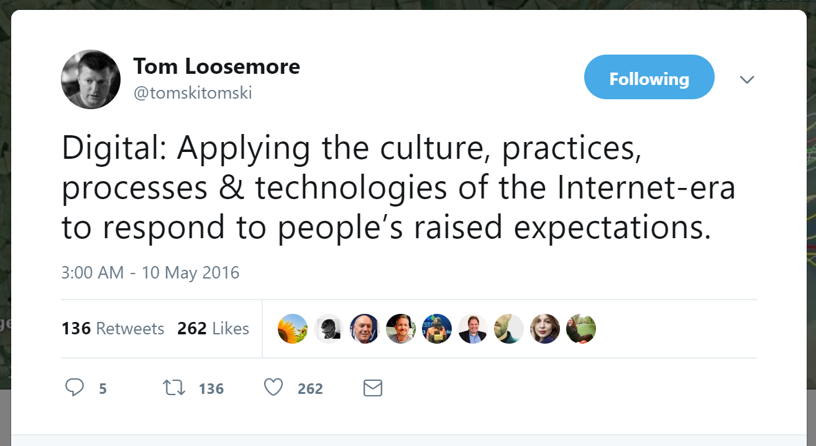

Slide 4
Leadership based on ten digital standards
1
Design with users
6
Build in accessibility from the start
Empower staff to deliver better services
2
Iterate and improve frequently
7
3
Work in the open by default
8
Be good data stewards
4
Use open standards and solutions
9
Design ethical services
5
Address security and privacy risks
10
Collaborate widely
Notes:
Inspired by Government of Canada Digital Standards
Design with users
Iterate and improve frequently
Work in the open by default
Use open standards and solutions
Address security and privacy risks
Build in accessibility from the start
Empower staff to deliver better services
Be good data stewards
Design ethical services
Collaborate widely

Slide 5





Digital Academy: the overview
Premium
to build organizational capacity
Foundations
digital open learning and Digital 101 for all public servants
Leadership
to lead and implement digital transformation
Digital Academy
Certification and aftercare
to provide access to tools and communities
Practicum
to connect leaders and practitioners around problems

Slide 6
Digital Academy: the update
Premium
to build organizational capacity
Prototype AI, Data, Design, and DevOps
January – April 2019
Foundations
digital open learning and Digital 101 for all public servants
Building to a critical mass throughout 2019
5, 800+ reached through busrides.ca
Leadership
to lead and implement digital transformation
Prototype Leadership cohort
March - April 2019
Digital Academy
Certification and aftercare
to provide access to tools and communities
Onboarding 5 external and 10 internal Fellows and building the team
Practicum
to connect leaders and practitioners around problems
May – June 2019

Slide 7


Digital foundations
1
A variety of learning opportunities to raise awareness and literacy for public servants
Combination of original content, third party solutions and community interactions
Digital 101 online and across all of Canada
Notes:
Digital Foundations
A variety of learning opportunities to raise digital awareness and literacy for public servants.
Combination of original content, third part solutions and community interactions.
Learners will have access to material of a variety difficulty levels.

Slide 8





2
Premium:
Specialized learning
Data: skills and tools required to conduct analytics, develop and test hypotheses, visualize and share reproducible results
Design: skills related to techniques and tools used in user experience research and service design in a digital age
Artificial intelligence and machine learning: practical experience in developing and using algorithms to learn from and make predictions or decisions based on data
DevOps: application & Web development and coding; includes bootcamp in developing web and mobile applications
Disruption: understanding technology and how it’s impacting and could impact Canada
Notes:
Digital Foundations
A variety of learning opportunities to raise digital awareness and literacy for public servants.
Combination of original content, third part solutions and community interactions.
Learners will have access to material of a variety difficulty levels.

Slide 9
Premium: Sample Data Curriculum
1
Data science universals
7
Basic data analytics techniques
2
Basics of programming
8
Measures and metrics
Statistical and math foundations
Advanced data visualization and reporting
3
9
4
Data and information architecture
10
Unstructured data and sentiment analysis
5
Data collection and processing
11
Predictive analytics
6
Data exploration and visualization
Notes:
Inspired by Government of Canada Digital Standards
Design with users
Iterate and improve frequently
Work in the open by default
Use open standards and solutions
Address security and privacy risks
Build in accessibility from the start
Empower staff to deliver better services
Be good data stewards
Design ethical services
Collaborate widely

Slide 10
Premium: Sample AI/ML Curriculum
1
Data science universals
7
Data mining
2
Basics of programming
8
Classification and value estimation
3
Statistical and math foundations
9
Clustering
4
Data and information architecture
10
Unstructured data and sentiment analysis
5
Data collection and processing
11
Introduction to deep learning
6
Data exploration and visualization
Notes:
Inspired by Government of Canada Digital Standards
Design with users
Iterate and improve frequently
Work in the open by default
Use open standards and solutions
Address security and privacy risks
Build in accessibility from the start
Empower staff to deliver better services
Be good data stewards
Design ethical services
Collaborate widely

Slide 11
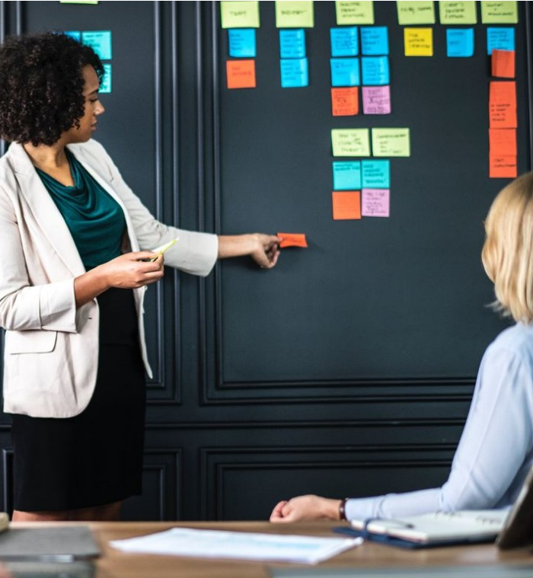
3
Leadership
1
Digital solutions
Lead agile teams in designing, delivering and operating services
Leverage data as a business asset
Use innovative and modern skill-sets and tools to deliver value
Collaborate and partner effectively with others
Change leadership within organizations
2
Digital for Senior Leaders
Understand the drivers of success of a digital government
Be attuned to digital’s potential disruptive impact on culture and processes
Rethink how they organize, measure, recruit, share ideas and partner
Notes:
Digital Foundations
A variety of learning opportunities to raise digital awareness and literacy for public servants.
Combination of original content, third part solutions and community interactions.
Learners will have access to material of a variety difficulty levels.

Slide 12
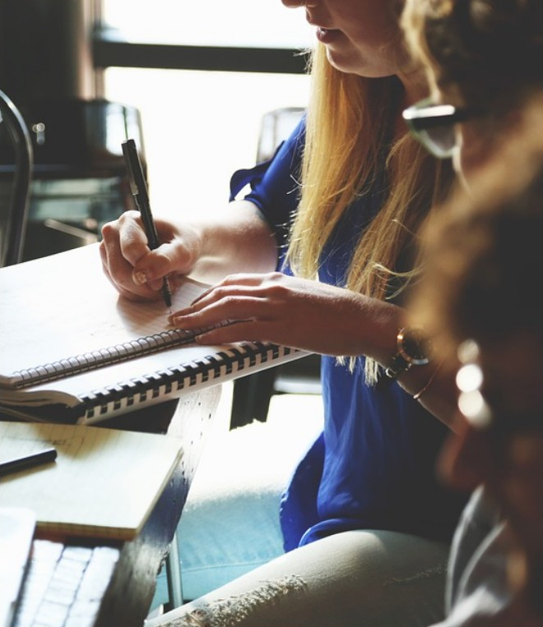
4
Practicum
Connecting leaders and practitioners around real problems
Real projects or challenges are brought from the host organization of participants in the Leadership stream
Practitioners are matched with leaders to learn through the completion of a project or challenge
Coaches and mentors support the project team in achieving results
Learners are evaluated in their abilities and their competencies throughout the practicum
Notes:
Digital Foundations
A variety of learning opportunities to raise digital awareness and literacy for public servants.
Combination of original content, third part solutions and community interactions.
Learners will have access to material of a variety difficulty levels.

Slide 13
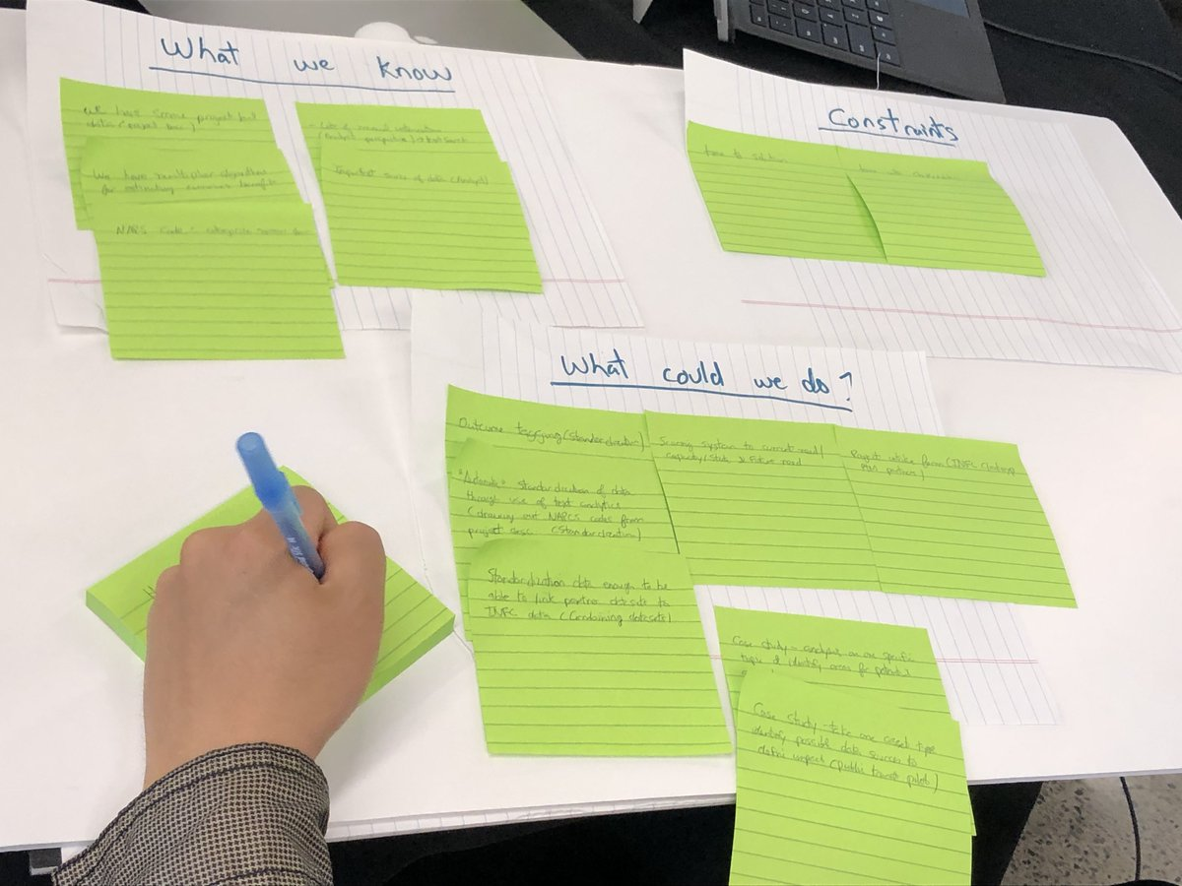
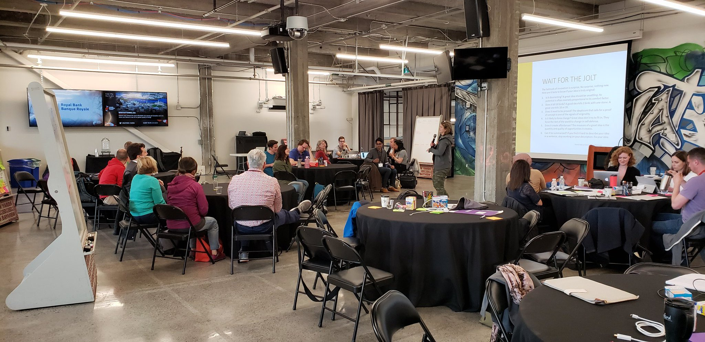
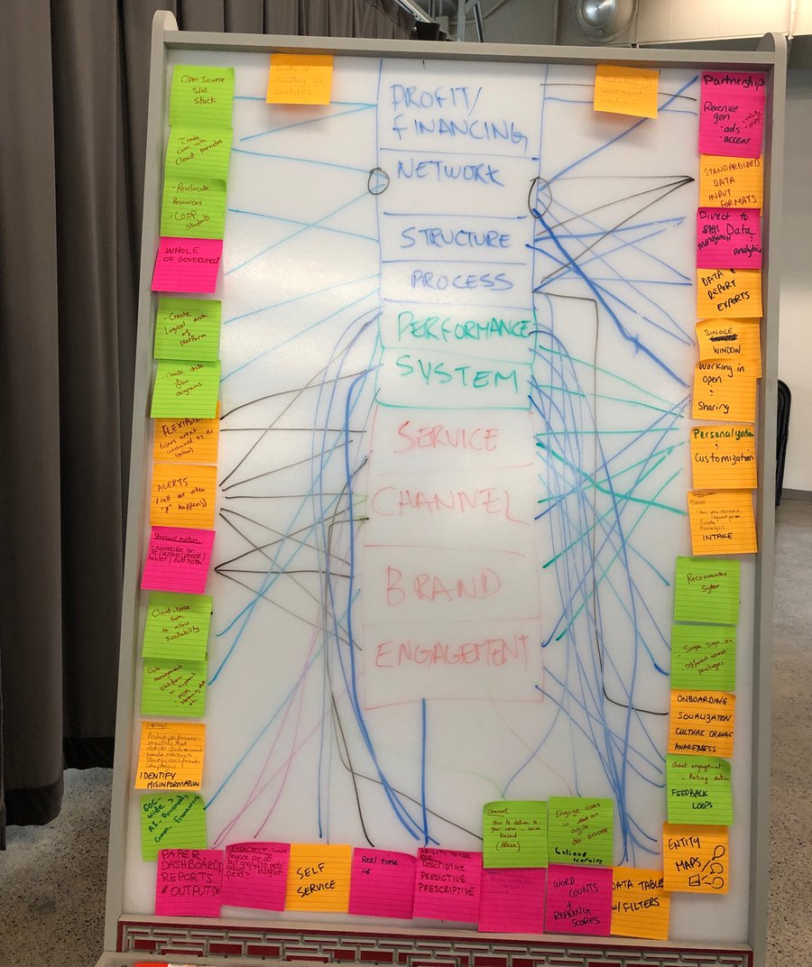
Week 1
Notes:
Digital Foundations
A variety of learning opportunities to raise digital awareness and literacy for public servants.
Combination of original content, third part solutions and community interactions.
Learners will have access to material of a variety difficulty levels.

Slide 14
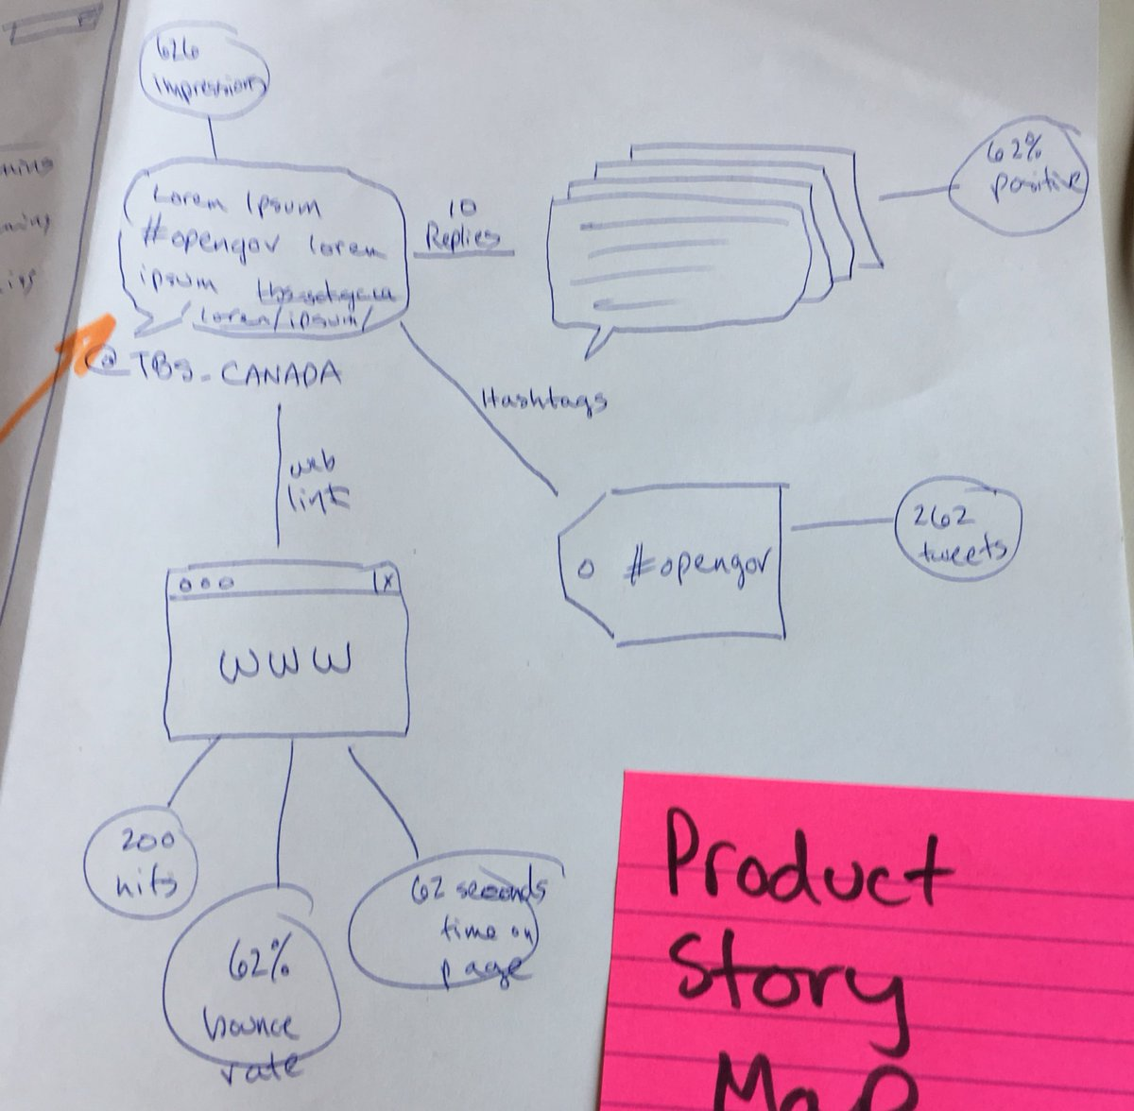
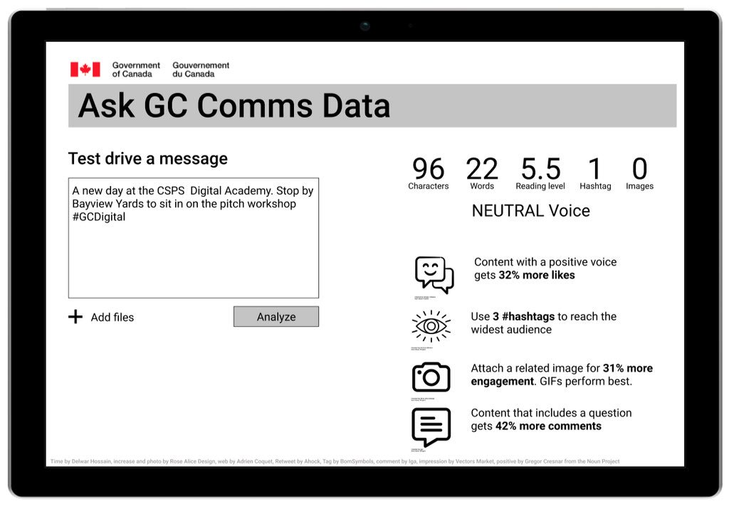
Week 2
Notes:
Digital Foundations
A variety of learning opportunities to raise digital awareness and literacy for public servants.
Combination of original content, third part solutions and community interactions.
Learners will have access to material of a variety difficulty levels.

Slide 15
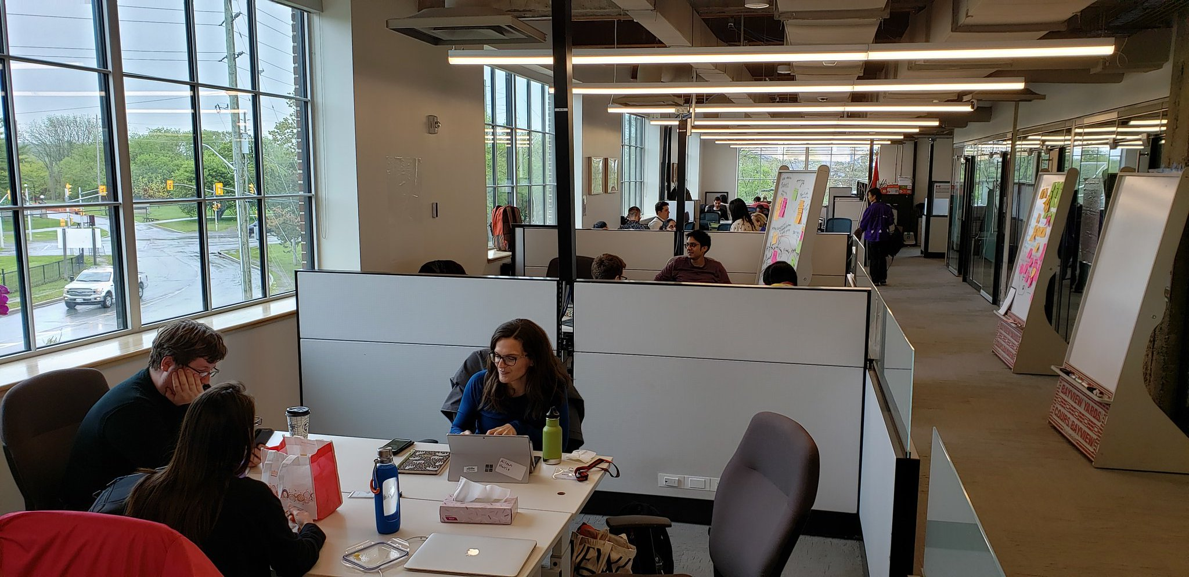
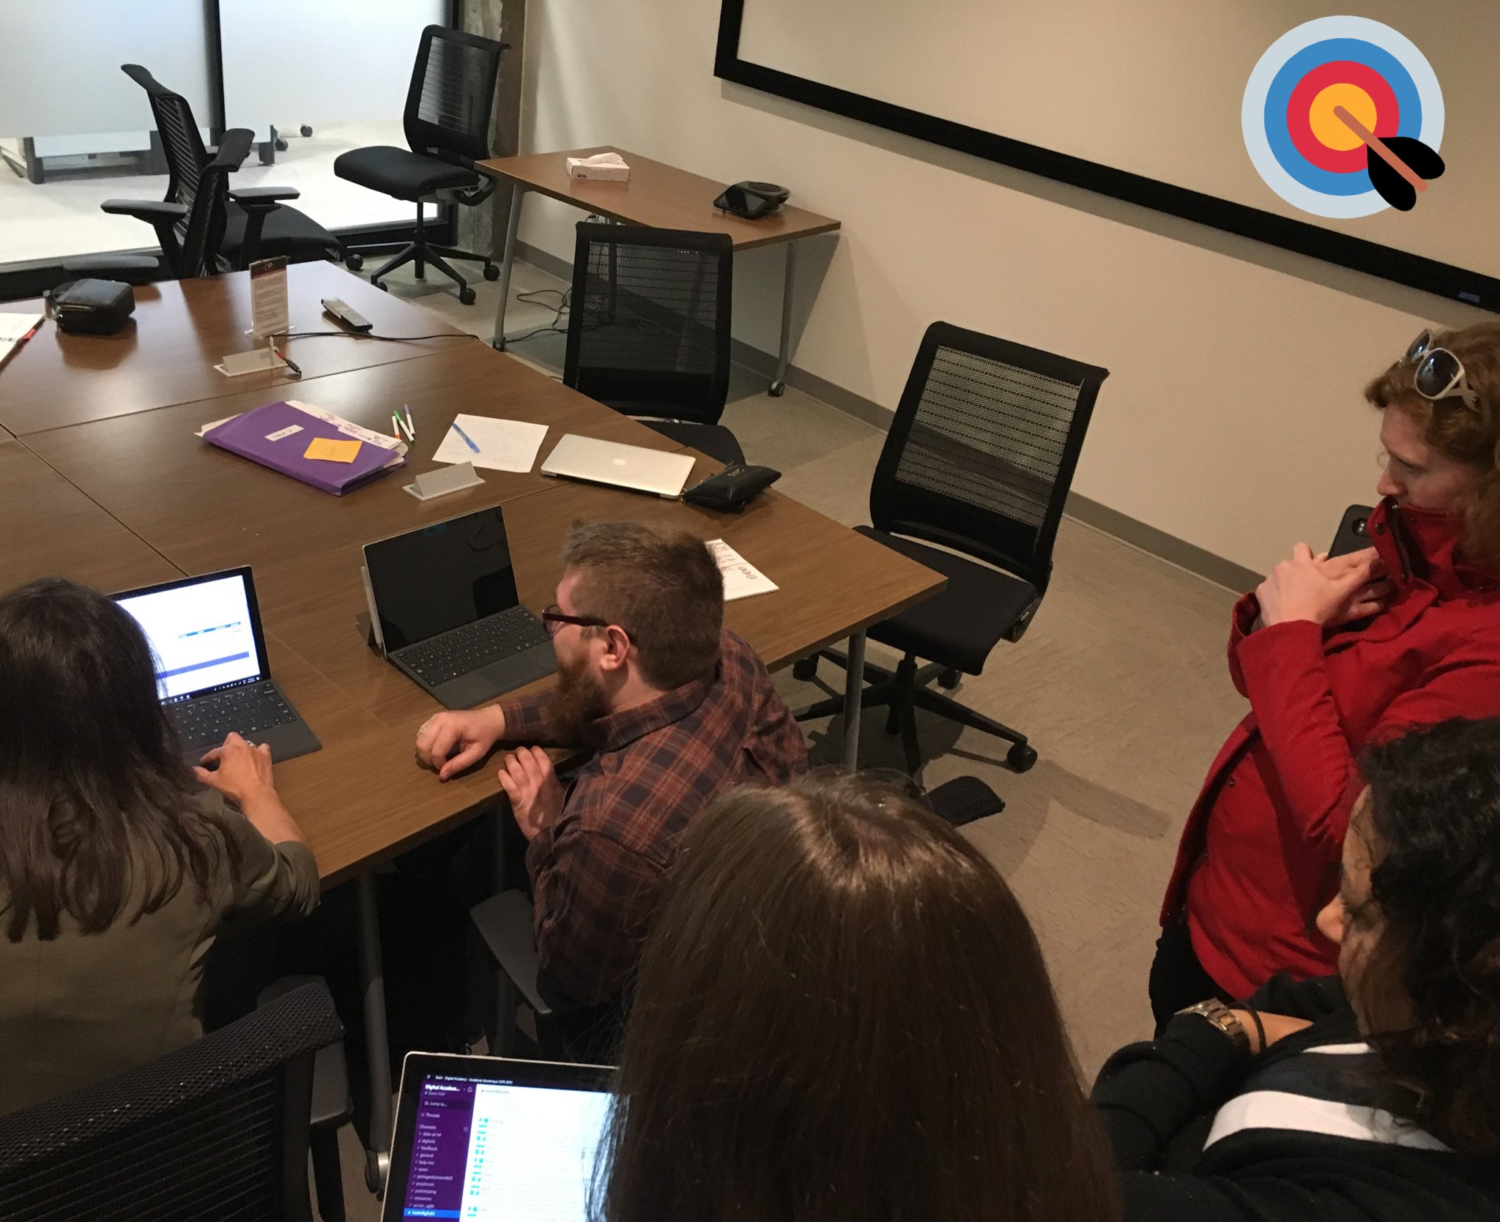
Week 3
Notes:
Digital Foundations
A variety of learning opportunities to raise digital awareness and literacy for public servants.
Combination of original content, third part solutions and community interactions.
Learners will have access to material of a variety difficulty levels.

Slide 16
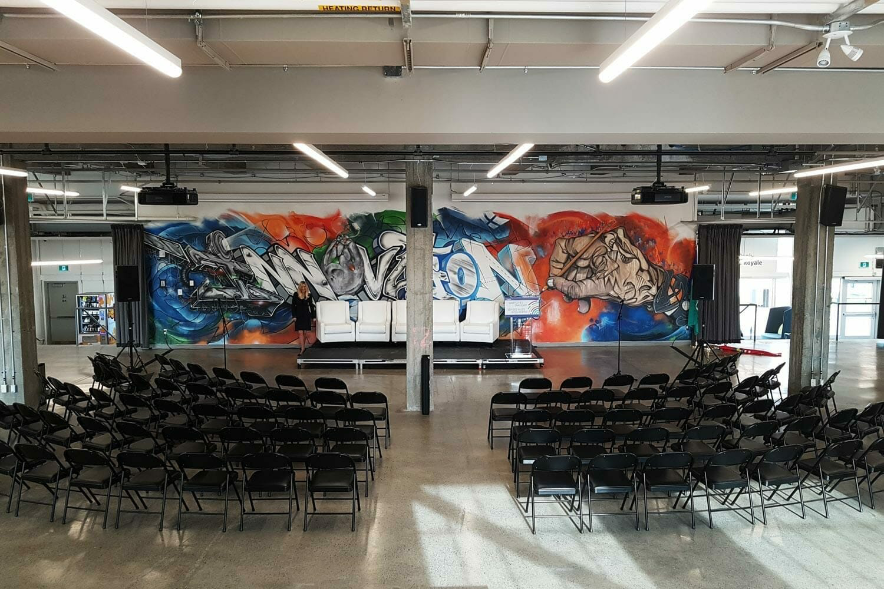
Showcase Day:
June 11, 2019
Notes:
Digital Foundations
A variety of learning opportunities to raise digital awareness and literacy for public servants.
Combination of original content, third part solutions and community interactions.
Learners will have access to material of a variety difficulty levels.

Slide 17
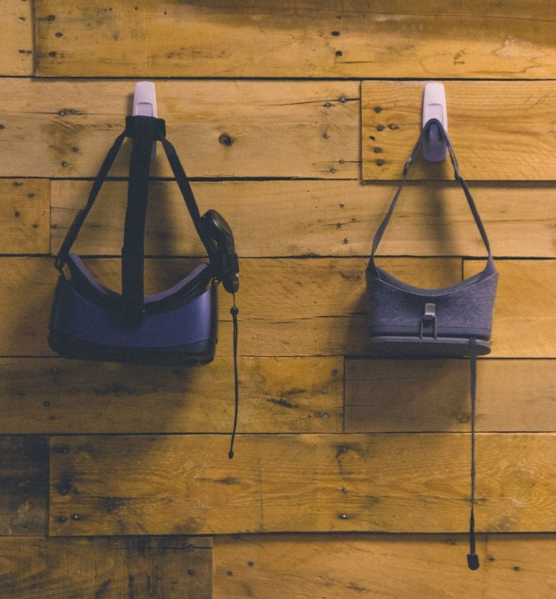
5
Certification and aftercare
Connecting leaders and practitioners around real problems
Learners in leadership and specialist streams will be certified on demonstration of skills and competencies, and will gain:
Access to the Digital Academy’s innovative and collaborative workspace
Access to modern tools and equipment to conduct experiments and proofs of concepts
Access to a cloud data learning sandbox
Invitation to community events and networking platform
Notes:
5. Certification and After Care
Learners in leadership and specialist streams will be certified on demonstration of skills and competencies, and will gain:
Access to the Digital Academy’s innovative and collaborative workspace.
Access to modern tools and equipment to conduct experiments and proofs of concepts.
Access to a cloud data learning sandbox.
Invitation to community events and networking platform.

Slide 18
Timeline
Where we’ve been
(since October 2018)
Busrides.ca launch
October 29
Prototype specialist programs
January – April
Practicum
May - June
Where we’re going
(fall 2019)
Foundations
Digital open learning
Digital 101
Other “anchor” courses
Premium, Leadership, and Practicum
Evaluate, iterate, and scale
Community, aftercare, and events
Ramping up throughout 2019
Specialist and leadership capacity for 200-300 learners in 2019 (~15 per stream per cohort)
Scale through partnerships to reach up to 1,000+ in-depth learners per year
Reach through Digital Open Learning to reach 10k-100k+ public servants

Slide 19

Thank you
Ashley Evans
ashley.evans@canada.ca
Sean Kibbee
sean.kibbee@canada.ca
Sam Louden
sam.louden@canada.ca
Notes:
5. Certification and After Care
Learners in leadership and specialist streams will be certified on demonstration of skills and competencies, and will gain:
Access to the Digital Academy’s innovative and collaborative workspace.
Access to modern tools and equipment to conduct experiments and proofs of concepts.
Access to a cloud data learning sandbox.
Invitation to community events and networking platform.

Slide 20








Digital Academy direction and curriculum
Departmental analyses and needs
Canadian Digital Service training needs analysis
Beyond 2020:
equipped, agile, inclusive
International best practices and comparators
Academy planning
CSPS research and leadership
Chief Information Officer of Canada direction
Government of Canada data strategy
Government of Canada policy direction
Notes:
Digital academy direction and curriculum
Academy planning consists of:
Departmental analyses and needs
Beyond 2020: equipped, agile, inclusive
CSPS research and leadership
Government of Canada data strategy
Government of Canada policy direction
Chief Information Officer if Canada direction
International best practices and comparators
Canadian Digital Service training needs analysis

Slide 21
Leadership: Curriculum overview
Digital Solutions
Digital for Senior Leaders
(EX minus-1 – Ex-03)
(EX-03 - 05)
Hiring and leading multi-disciplinary teams and specialized skills
Communicating 360 for results
Leading agile projects
Leading user-centered solutions
Coaching others
Change management and resilience
Servant leadership
Building digital acumen
Fostering collaboration and boundary spanning
Fostering risk-taking and experimentation
Providing sponsorship and Governance in Agile Environments
Nudging transformation
Notes:
Leadership: curriculum overview
Digital Solutions (EX-01-03)
Hiring and leading multi-disciplinary teams and specialized skills
Communicating 360 for results
Leading agile projects
Leading user-centred solutions
Coaching others
Change management and resilience
Servant leadership
Building digital acumen
Digital for senior leaders (EX-03-05)
Fostering collaboration and boundary spanning
Fostering risk-taking and experimentation
Providing sponsorship and government in agile environments
Nudging and transformation

Slide 22
Foundations: Curriculum overview
Digital government
Showcase domestic and international government best practices, policies, and tools and innovation to educate and inspire across government and beyond.
Design foundations
Enable public servants to use digital information and communication platforms to find, evaluate, create, and communicate clear information.
Digital literacy
Encourage public servants to work in a more iterative and creative approach while basing the design of government products and services on end-users’ needs, wants, and limitations
Technology and tools
Foster the use and exploration of technologies to inspire more efficient and innovative ways of working in the public service.
Notes:
Foundations: curriculum overview
Digital government: showcase domestic and international government best practices, policies and tools and innovations to educate and inspire across government and beyond.
Digital literacy: encourage public servants to work in a more iterative and creative approach while basing the design of government products and services on end-user’s needs, wants, and limitations.
Design foundations: enable public servants to use digital information and communication platforms to find, evaluate, create, and communicate clear information.
Technology and tools: foster the use and exploration of technologies to inspire more efficient and innovative ways of working in the public service.

Slide 23
Premium: Sample Design Curriculum
1
Design thinking
6
User interface
2
Design research
7
Interaction design
3
Content design
8
Data visualization
4
Information architecture
9
Usability testing
5
Service design
10
Prototyping
Notes:
Inspired by Government of Canada Digital Standards
Design with users
Iterate and improve frequently
Work in the open by default
Use open standards and solutions
Address security and privacy risks
Build in accessibility from the start
Empower staff to deliver better services
Be good data stewards
Design ethical services
Collaborate widely

Slide 24
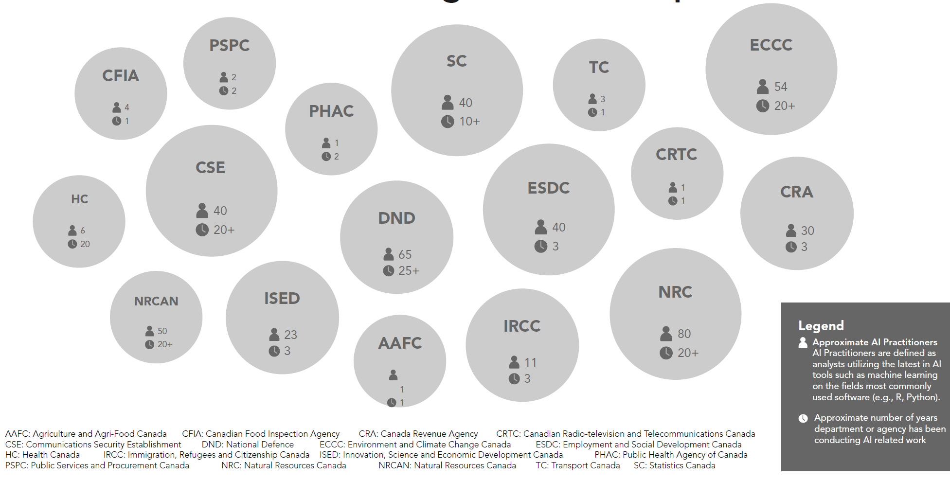
Who’s working with AI in the GC

Slide 25

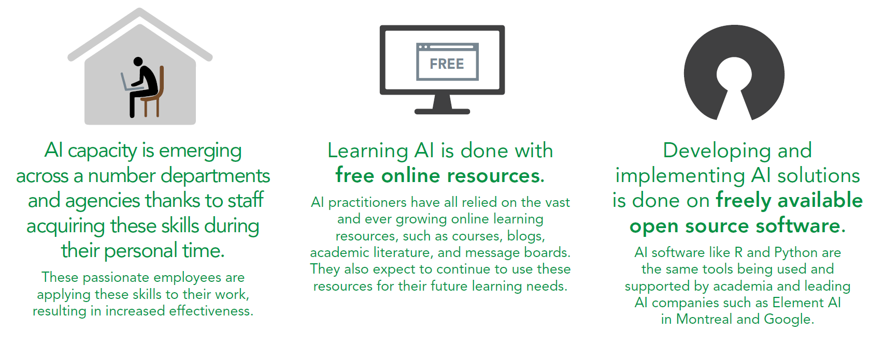
AI capacity building in the GC
AI capacity is emerging across organizations thanks to staff acquiring these skills during their personal time
Developing AI solutions is done freely available on open source software
Learning AI is done with free online resources
*This slide and last: the work of Mathieu Audet, which can be found on GCcollab through the GC Entrepreneurs group

